Slide 1

Intoy ERP Project Implementation
Comprehensive Case Study using Odoo Platform
PRESENTED BY
SUPERVISED BY
Amira Mrabet & Ahmed Riadh Hedhili
Dr. Zakia ZOUAGHIA
Group: L2CS02
Academic Year: 2025-2026

Slide 2

Introduction to ERP Systems
ERP (Enterprise Resource Planning) is an integrated software suite that connects all departments into a single unified database.
Key Benefits
Data Integration
One source of truth for the entire
By centralizing data, ERP systems eliminate information silos, allowing departments like Sales, Inventory, and Accounting to work in perfect synchronization.
company.
Improved Productivity
Automated workflows and reduced
manual errors.
Cost Savings
Optimized stock levels and
streamlined operations.
Better Decisions
Real-time insights and advanced
financial reporting.

Slide 3

Introducing "Intoy"
The Toy & Doll Specialists
Intoy is a digital-first retail platform specializing in premium toys that support child development and creative play.
Strategic Goal
Dolls & Plush Teddy Bears
Implement a scalable ERP solution to unify
fragmented retail operations into a seamless digital
Educational & Interactive Games
ecosystem.
Toy Vehicles & Action Figures
Gift Wrapping & Custom Services
Customer Experience
Enhance satisfaction through real-time stock
availability and efficient order fulfillment.

Slide 4

Company Setup & User Management
Activity 2: User Roles
Activity 1: Setup
User & Role
Responsibilities & Powers
COMPANY NAME
Intoy
Managing customer relationships, creating sales orders, and tracking sales opportunities.
CURRENCY
Mohamed Ammar
TND (Tunisian Dinar)
Sales Manager
SLOGAN
Handling financial transactions, managing vendor bills, customer invoices, and payments.
"Gifts of joy for every child"
Fatima Ali
Accountant
LOCATION
Tunis, Tunisia
Promoting products to target audiences and managing brand communication.
Sarah Hamdi
Marketing

Slide 5
Core Module Installation
CRM
Sales
Purchases
Accounting
Inventory
Managing customer information, tracking sales opportunities, and streamlining communication.
Creating sales orders, managing product deliveries, and generating customer invoices.
Managing supplier relations, creating purchase orders, and receiving goods.
Handling financial entries, managing payments, and generating comprehensive reports.
Real-time stock tracking, warehouse management, and inventory movements.

Slide 6

Master Data Management
Partner Management
Product Catalog
KEY CUSTOMERS
PRODUCT NAME
TYPE
PRICE
Wonderland Kids Nursery, Sarah Ahmed,
Barbie Doll (Pink Dress)
Storable
15 TND
Happy Birthday Events
Plush Teddy Bear
Storable
20 TND
KEY SUPPLIERS
Global Toy Manufacturers, SoftDreams
Gift Wrapping Service
Service
3 TND
Plushies Co., EduPlay Solutions
Classic Strategy Game
Storable
10 TND

Slide 7

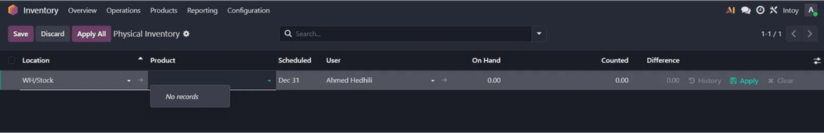
Inventory & Warehouse Management
ODOO INVENTORY AUDIT
Intoy Warehouse
The primary virtual hub managing all incoming and outgoing toy shipments.
Main Showroom (WH/Stock)
Front-end display area optimized for direct customer sales and browsing.
Central Storage (WH/Storage)
Back-end facility for bulk inventory and large-scale toy sets.

Slide 8
Purchasing Workflow (BPMN)
01
02
03
Procurement
Logistics
Finance
Create RFQ: Requesting quotes from toy suppliers.
Receive Products: Physical arrival of dolls and games.
Vendor Bill: Recording the invoice in the accounting module.
Confirm PO: Converting the best quote into a formal Purchase Order.
Validate: Confirming quantities match the order in Intoy Warehouse.
Payment: Registering the bank transfer to settle the debt.
Seamless Integration: From Procurement to Financial Settlement

Slide 9

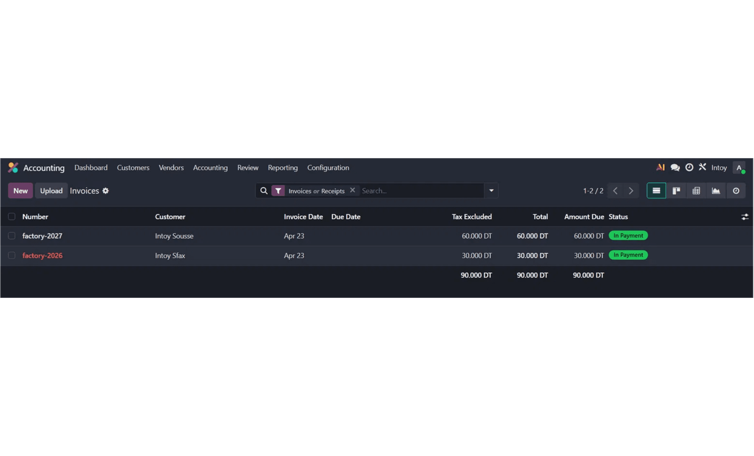
Sales & Financial Cycle
Payment Status: Paid
Order Fulfillment
Converting quotations to Sale Orders and managing toy deliveries.
Invoicing & Collection
Generating customer invoices and registering payments in Accounting.
Inventory Audit
Ensuring physical stock levels match digital records in Odoo for accurate reporting.

Slide 10
Process Modeling (BPMN)
Sales Process Analysis
Purchase Approval Logic
Maps the journey from initial customer inquiry to final payment collection.
Standardizes the procurement cycle from RFQ to Vendor Bill settlement.
Integrates Sales, Warehouse (Logistics), and Accounting departments.
Includes critical validation steps for physical goods reception in Intoy Warehouse.
Ensures stock availability checks are performed before order confirmation.
Automates financial liability recording upon invoice validation.
Strategic Value: BPMN diagrams visualize complex workflows to identify bottlenecks and ensure Standard Operating Procedures (SOPs).

Slide 11

Conclusion & Key Learnings
Project Outcomes
Operational Efficiency
The implementation of Odoo for Intoy successfully unified fragmented retail operations into a single digital ecosystem.
Automation of workflows significantly reduces human error and speeds up business execution.
Data Consistency
We achieved a full business lifecycle simulation, from initial procurement to final customer payment collection.
Centralized databases ensure that Sales, Inventory, and Accounting always share the same "truth".
Strategic Insights
Real-time reporting provides a competitive edge for better decision-making in modern business.

Slide 12

Thank You!
Any Questions?
ACKNOWLEDGMENTS
"We would like to express our sincere gratitude to Dr. Zakia ZOUAGHIA for her valuable guidance and support throughout this project, which greatly enhanced our understanding of ERP systems."

